Slide 1
INTELLECTUAL DISABILITY IN A 5 YEAR OLD BOY: WHAT & WHY?
Jose Lopez-Vera, MS-4
Neelkamal Soares, MD
Western Michigan University Homer Stryker M.D. School of Medicine
Kalamazoo, Michigan, USA

Slide 2
OBJECTIVES
After this podcast/discussion, the learner will be able to:
Distinguish between developmental delay (DD) and intellectual disability (ID)
Articulate the rationale for genetic testing in children with DD or ID
Discuss some of the findings in patients with fragile X syndrome

Slide 3
THE CASE
5 year old boy
School physical visit to primary pediatrician
He has no current illness or concerns.
Family history is unremarkable, he is the only child, raised by single mother, little information about father.
His physical exam is unremarkable

Slide 4
THE CASE CONTINUED…
Past records available:
History of developmental delay at age 4
Referred for educational testing to local school district
“intellectual impairment”, intelligence quotient (IQ) score of 61, and adaptive score of 63 on school testing
Neurologist evaluation with lab testing
Negative chromosomal microarray
Fragile X molecular test – 240 CGG repeats

Slide 5
“SEVERITY” OF ID
In the past, severity of ID was based on the IQ scores
Mild (52-69)
Moderate (36-51)
Severe (20-35)
Profound (19 or below)
However, IQ scores are not reliable as they get lower, adaptive functioning is more realistic
Severity is now based on the 3 domains (practical, conceptual and social) and how an individual functions and what degree of supports he/she needs

Slide 6
FIRST THINGS FIRST…. DIAGNOSIS?
Intellectual disability (ID): significant limitations both in intellectual functioning and adaptive behavior as expressed in conceptual, social, and practical adaptive skills, that originates before the age of 18. (American Association on Intellectual and Developmental Disabilities (AAIDD), 2010)
Mental retardation is the archaic term (pre-2007), when the AAIDD substituted it with ID.

Slide 7
HOW IS DEVELOPMENTAL DELAY DIFFERENT?
Global developmental delay (GDD): failure to attain expected developmental milestones in 2 or more areas of functioning
ID is usually identified later than GDD (after age 5), and is usually chronic in nature.
GDD is diagnosed when children are too young or too impaired to undergo systematic assessment of various levels of functioning
Not all children with GDD are found later to have ID

Slide 8
SO WHAT ARE THE CRITERIA FOR ID?
Diagnostic criteria from the Diagnostic & Statistical Manual of Mental Disorders, 5th edition (DSM-5) is used by clinicians and researchers across North America.
Intellectual Developmental Disorders and Intellectual Disability (ID) are used synonymously. The diagnostic criteria are:
Deficits in intellectual function
Deficits in adaptive functioning that result in failure to meet developmental and sociocultural standards for personal independence and social responsibility.
Onset of intellectual and adaptive deficits during the developmental period.

Slide 9
WHO CAN DIAGNOSE ID?
Professionals who either conduct or review standardized evaluations of intelligence and adaptive functioning
Physicians (primary or subspecialists) may identify deficits in adaptive functioning
Psychologists (clinical, educational, neuropsychologists) generally conduct intelligence assessment, and also conduct adaptive assessment
Should not be diagnosed based on “opinion” or non-standardized testing or history of delays
Often, diagnosis will be revisited after a period of time (~ 2-3 years) to ensure the individual still meets criteria
Educational qualification of ID and medical diagnosis of ID may not be concordant as different systems use different nomenclature and criteria

Slide 10
WHAT IS FRAGILE X SYNDROME?
Most common inherited form of intellectual disability
1 in 4000 males, 1 in 6000 females
1 in 151 females and 1 in 468 males are carriers of the premutation
Causes intellectual disability, behavioral and learning challenges, and various physical characteristics.

Slide 11
PHYSICAL CHARACTERISTICS
Physical features vary from patient to patient.
Often, features are not obvious when younger, and become more pronounced in adolescence.
Physical features include:
Facial: Large ears, Long face. Prominent jaw
Connective tissue: flat feet, high arched palate, double jointed fingers and hyper-flexible joints
Strabismus
Low muscle tone
Macro-orchidism (post-pubertal)
Photo used with permission from Paula Fasciano

Slide 12
COMORBIDITIES
NEUROPSYCHIATRIC
Attention Deficit/Hyperactivity Disorder
Autism Spectrum Disorder
Social Anxiety Disorder
Sensory Integration Difficulties
Intellectual Disability
Repetitive behaviors (hand flapping)
Self-injury, aggression
MEDICAL
Gastroesophageal Reflux Disease
Obstructive Sleep Apnea
Recurrent sinusitis/otitis media
Decreased visual acuity
Scoliosis
Mitral Valve Prolapse

Slide 13
HOW IS FRAGILE X TESTED?
Southern blot and PCR technologies look for a trinucleotide repeat (CGG) in the FMR1 gene.
The FMR1 gene encodes the fragile X mental retardation protein (FMRP), which is a regulatory protein that binds mRNA in neurons and dendrites.
In a full mutation, FMRP is not made due to hypermethylation of FMR1, brain development is impaired due to abnormal synapse connections. It also can lead to excessive activity of the metabotropic glutamate receptor 5 (mGluR5) which results in many fragile X symptoms in other tissues.
Karyotype – not performed anymore

Slide 14
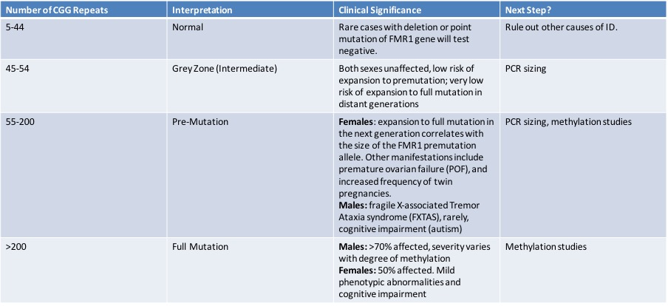
GENETIC PRESENTATIONS OF FRAGILE X
Gene Reviews 2012
Notes:
Normal 5-44
45-54 intermediate
55-200 is premutation
>200 is full mutation.

Slide 15
SO WHY DO GENETIC TESTING IN ID?
Advances in testing technology have increased the diagnostic yield of genetic etiology for ID or GDD from 6–10% a few years ago to 30–40%.
Recommended tests by American Academy of Pediatrics and American College of Medical Genetics include
chromosomal microarray (CMA)
DNA probe for fragile X.
Proposed benefits
improved patient and family education of diagnosis and expected clinical course
refining treatment and avoiding unnecessary tests
Genetic tests are for establishing diagnosis, not confirming a clinical diagnosis.

Slide 16
OTHER TRINUCLEOTIDE REPEAT DISORDERS
Huntington’s Disease - CAG
Friedreich’s Ataxia - GAA
Myotonic dystrophy - CTG
Spinocerebellar ataxia - CAG
Spinal and bulbar muscular atrophy (SBMA) - CAG
…and several others

Slide 17
COMORBIDITIES
NEUROPSYCHIATRIC
Attention Deficit/Hyperactivity Disorder
Autism Spectrum Disorder
Social Anxiety Disorder
Sensory Integration Difficulties
Intellectual Disability
Repetitive behaviors (hand flapping)
Self-injury, aggression
MEDICAL
Gastroesophageal Reflux Disease
Obstructive Sleep Apnea
Recurrent sinusitis/otitis media
Decreased visual acuity
Scoliosis
Mitral Valve Prolapse

Slide 18
LATE COMPLICATIONS OF FRAGILE X
Fragile X Associated Tremor/Ataxia Syndrome (FXTAS)
premutation in FMR1 and white matter lesions on MRI in middle cerebellar peduncles and/or brain stem with intention tremor or gait ataxia.
FMR1 Related Primary Ovarian Insufficiency (FXPOI)
cessation of menses before age 40 years in a woman with FMR1 premutation.

Slide 19
INTERPROFESSIONAL APPROACH
Child & Family
Healthcare
School
Rehabilitation
Primary Clinicians
Pharmacist
Mental Health
Counselor
Educators
Speech
Therapy
Physical and
Occupational
Therapy
Support
Staff
Specialists
Psychiatrist
Frag X has no cure
Some emerging targeted therapies, but so far clinical trials either underway or inconclusive
Supportive treatment addresses the medical and neuropsychiatric comorbidities, educational and rehabilitative therapies and genetic counseling

Slide 20
TAKE HOME POINTS
The term “Mental retardation” is archaic, now replaced with “intellectual disability” (ID)
Global developmental delay (GDD) is the term used most often in younger children (and with less severity)
Genetic testing is indicated in searching for diagnosis in ID and GDD
Fragile X syndrome is the most common inherited cause of ID
Fragile X has many disease manifestations: physical, cognitive, psychosocial
An interprofessional approach is often required in the care of individuals with fragile X syndrome.

Slide 21
REFERENCES
Saul RA, Tarleton JC. FMR1-Related Disorders. [Updated 2012 Apr 26]. In: Adam MP, Ardinger HH, Pagon RA, et al., editors. GeneReviews [Internet]. Seattle (WA): University of Washington, Seattle; 1993-2018. Available from: https://www.ncbi.nlm.nih.gov/books/NBK1384/
FXS — National Fragile X Foundation. Retrieved March 28, 2018, from https://fragilex.org/learn/
Home | Fragile X Syndrome (FXS) | NCBDDD | CDC. Retrieved March 28, 2018, from https://www.cdc.gov/ncbddd/fxs/index.html
Hersh JH, Saul RA, Committee on Genetics. Health Supervision for Children With Fragile X Syndrome Pediatrics May 2011, 127 (5) 994-1006

